Slide 1

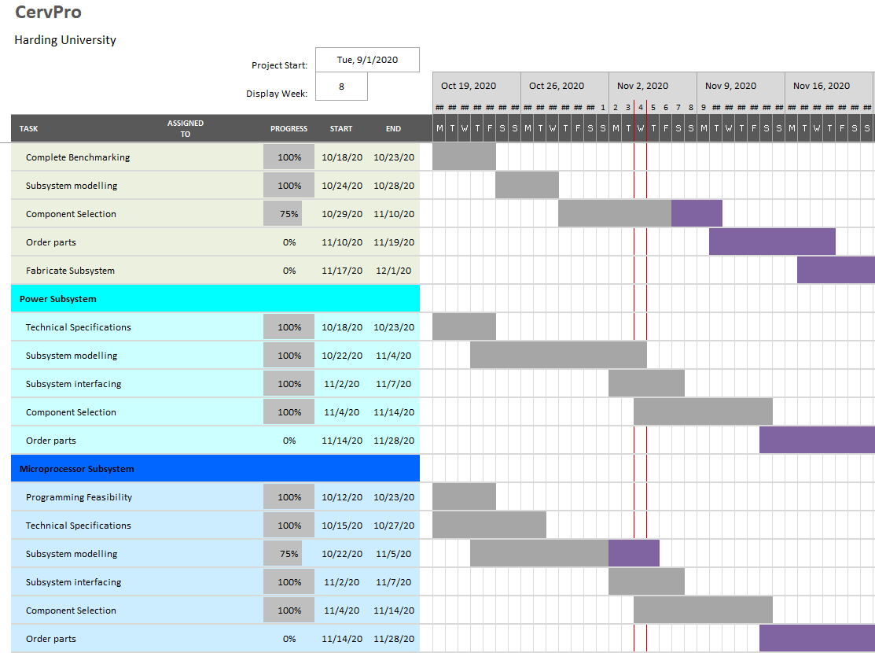
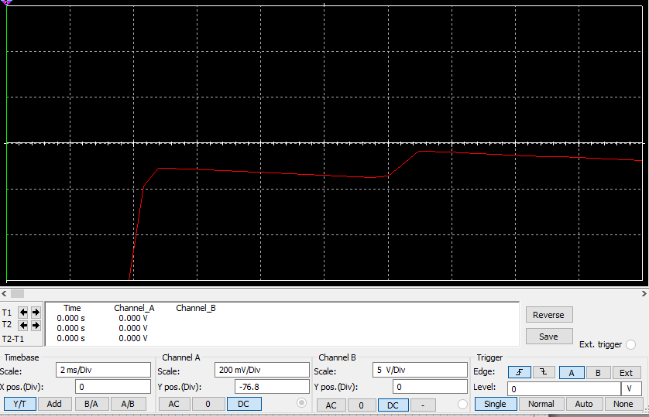

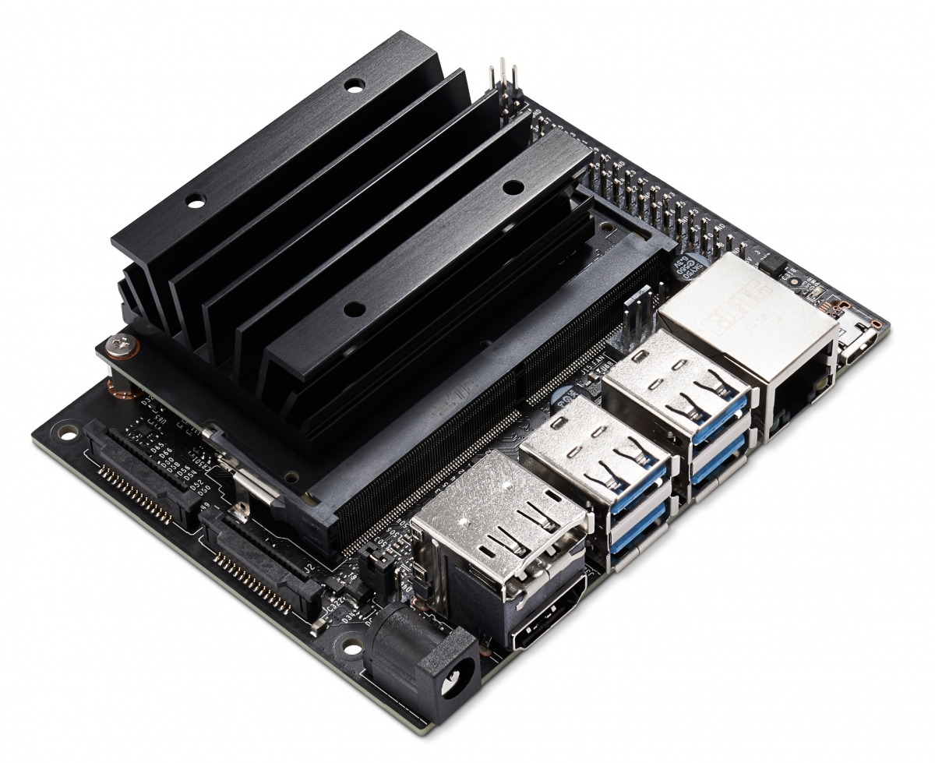
CervPro
Cervical Proprioception Diagnosis: A3 Status
Date: November 4, 2020
Members: Nathan Vielmette, Ethan Grimes, Keneth Chelelgo, and George Cook
Background
PT cervical proprioception (CP) assessments are subjective and determined by PT opinion.
Motivation is to create device that gives PTs objective data that shows patients’ ability to sense head and neck position in space.
Device will sense head position and angular velocity.
Proposed Countermeasures
Further analyze accuracy differences between one and two camera systems
Get motion capture program running on laptop before microprocessor
Recent Results
Device will be classified as a class 2 medical device
Internal specs developed (except for ripple in power supply)
Power supply design almost complete
Selected camera model
Selected microprocessor
Current Conditions
Goals/Targets
Use of device will be faster than double standard CPE test time
Patient will not need to touch any part of device
Accurately measures head position and speed
Device will be mobile and lightweight
Next Steps
Finish power supply (Nathan and George)
Start ordering power supply parts (Nathan)
Decide on 1 vs. 2 camera and program compatibility (George)
Analysis
Only using one camera may not be sufficient for accurate data
Motion capture program works in theory but not in practice

Slide 2
CervPro
Cervical Proprioception Diagnosis: A3 Status
Date: November 4, 2020
Members: Nathan Vielmette, Ethan Grimes, Keneth Chelelgo, and George Cook

Slide 3
CervPro
Cervical Proprioception Diagnosis: A3 Status
Date: November 4, 2020
Members: Nathan Vielmette, Ethan Grimes, Keneth Chelelgo, and George Cook

Slide 4
CervPro
Cervical Proprioception Diagnosis: A3 Status
Date: November 4, 2020
Members: Nathan Vielmette, Ethan Grimes, Keneth Chelelgo, and George Cook
Nvidia Jetson Nano:
5W/10W Power Modes
4 GB RAM at 25.6 GB/s (64 bit)
Quad-core at 1.43 GHz
5 USB, HDMI and DP, and 56 pins
Ubuntu-based OS
Cost: $99.00

